Slide 1
Operating Systems
Inter-Process Communication (IPC)
Notes:
‹#›

Slide 2
Interprocess Communication
Processes within a system may be independent or cooperating
Cooperating process can affect or be affected by other processes, including sharing data
Reasons for cooperating processes:
Information sharing
Computation speedup
Modularity
Convenience
Cooperating processes need interprocess communication (IPC)
Two models of IPC
Shared memory
Message passing

Slide 3
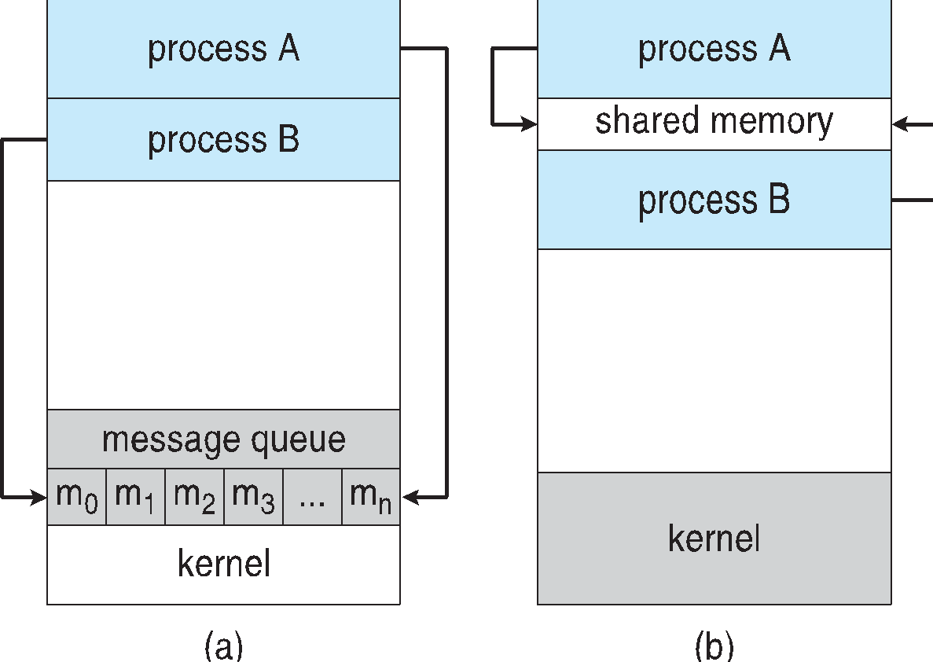
Communications Models
(a) Message passing. (b) shared memory.

Slide 4
Cooperating Processes
Independent process cannot affect or be affected by the execution of another process
Cooperating process can affect or be affected by the execution of another process
Advantages of process cooperation
Information sharing
Computation speed-up
Modularity
Convenience

Slide 5
Introduction to Concurrency
Classical Problems of Concurrency
Critical Regions
Monitors
Inter-Process Communication (IPC)
Communications in Client-Server Systems
A. Frank - P. Weisberg
Notes:
‹#›

Slide 6

Inter-Process Communication (IPC)
Mechanism for processes to communicate and to synchronize their actions.
Message system – processes communicate with each other without resorting to shared variables.
We have at least two primitives:
send(destination, message) or send(message)
receive(source, message) or receive(message)
Message size is fixed or variable.
A. Frank - P. Weisberg
Notes:
‹#›

Slide 7
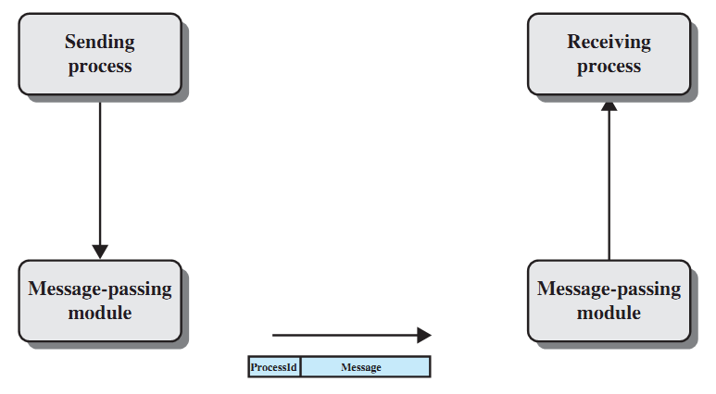
Basic Message-passing Primitives
A. Frank - P. Weisberg
Notes:
‹#›

Slide 8
Interprocess Communication
Processes within a system may be independent or cooperating
Cooperating process can affect or be affected by other processes, including sharing data
Reasons for cooperating processes:
Information sharing
Computation speedup
Modularity
Convenience
Cooperating processes need interprocess communication (IPC)
Two models of IPC
Shared memory
Message passing

Slide 9
Communications Models
(a) Message passing. (b) shared memory.

Slide 10
Cooperating Processes
Independent process cannot affect or be affected by the execution of another process
Cooperating process can affect or be affected by the execution of another process
Advantages of process cooperation
Information sharing
Computation speed-up
Modularity
Convenience

Slide 11

Message Passing
Message passing is a general method used for IPC:
for processes inside the same computer.
for processes in a networked/distributed system.
In both cases, the process may or may not be blocked while sending a message or attempting to receive a message.
A. Frank - P. Weisberg
Notes:
‹#›

Slide 12
Synchronization in message passing (1)
Message passing may be blocking or non-blocking.
Blocking is considered synchronous
Blocking send has the sender block until the message is received
Blocking receive has the receiver block until a message is available
Non-blocking is considered asynchronous
Non-blocking send has the sender send the message and continue
Non-blocking receive has the receiver receive a valid message or null
A. Frank - P. Weisberg
Notes:
‹#›

Slide 13
Synchronization in message passing (2)
For the sender: it is more natural not to be blocked after issuing send:
can send several messages to multiple destinations.
but sender usually expect acknowledgment of message receipt (in case receiver fails).
For the receiver: it is more natural to be blocked after issuing receive:
the receiver usually needs the information before proceeding.
but could be blocked indefinitely if sender process fails before send.
A. Frank - P. Weisberg
Notes:
‹#›

Slide 14
Synchronization in message passing (3)
Hence other possibilities are sometimes offered.
Example: blocking send, blocking receive:
both are blocked until the message is received.
occurs when the communication link is unbuffered (no message queue).
provides tight synchronization (rendezvous).
A. Frank - P. Weisberg
Notes:
‹#›

Slide 15
Synchronization in message passing (4)
There are really 3 combinations here that make sense:
Blocking send, Blocking receive
Nonblocking send, Nonblocking receive
Nonblocking send, Blocking receive – most popular – example:
Server process that provides services/resources to other processes. It will need the expected information before proceeding.
Notes:
‹#›

Slide 16
IPC Requirements
If P and Q wish to communicate, they need to:
establish communication link between them.
exchange messages via send/receive.
Implementation of communication link:
physical (e.g., shared memory, hardware bus)
logical (e.g., logical properties)
A. Frank - P. Weisberg
Notes:
‹#›

Slide 17

Link Capacity – Buffering
Queue of messages attached to the link; implemented in one of three ways:
1. Zero capacity – 0 messages Sender must wait for receiver (rendezvous).
2. Bounded capacity – finite length of n messages Sender must wait if link full.
3. Unbounded capacity – infinite length Sender never waits.
A. Frank - P. Weisberg
Notes:
‹#›

Slide 18
Direct/Indirect Communication
Direct communication:
when a specific process identifier is used for source/destination.
but it might be impossible to specify the source ahead of time (e.g., a print server).
Indirect communication (more convenient):
messages are sent to a shared mailbox which consists of a queue of messages.
senders place messages in the mailbox, receivers pick them up.
A. Frank - P. Weisberg
Notes:
‹#›

Slide 19
Direct Communication
Processes must name each other explicitly:
send(P, message) – send a message to process P
receive(Q, message) – receive a message from Q
Properties of communication link:
Links are established automatically.
A link is associated with exactly one pair of communicating processes.
Between each pair there exists exactly one link.
The link may be unidirectional, but is usually bi-directional.
A. Frank - P. Weisberg
Notes:
‹#›

Slide 20
Indirect Communication (1)
Messages are directed and received from mailboxes (also referred to as ports).
Each mailbox has a unique id.
Processes can communicate only if they share a mailbox.
Properties of communication link:
Link established only if processes share a common mailbox.
A link may be associated with many processes.
Each pair of processes may share several communication links.
Link may be unidirectional or bi-directional.
A. Frank - P. Weisberg
Notes:
‹#›

Slide 21

Indirect Communication (2)
Operations
create a new mailbox
send and receive messages through mailbox
destroy a mailbox
Primitives are defined as:
send(A, message) – send a message to mailbox A.
receive(A, message) – receive a message from mailbox A.
A. Frank - P. Weisberg
Notes:
‹#›

Slide 22

Indirect Communication (3)
Mailbox sharing
P₁, P₂, and P₃ share mailbox A.
P₁, sends; P₂ and P₃ receive.
Who gets the message?
Possible solutions:
Allow a link to be associated with at most two processes.
Allow only one process at a time to execute a receive operation.
Allow the system to select arbitrarily the receiver. Sender is notified who the receiver was.
A. Frank - P. Weisberg
Notes:
‹#›

Slide 23
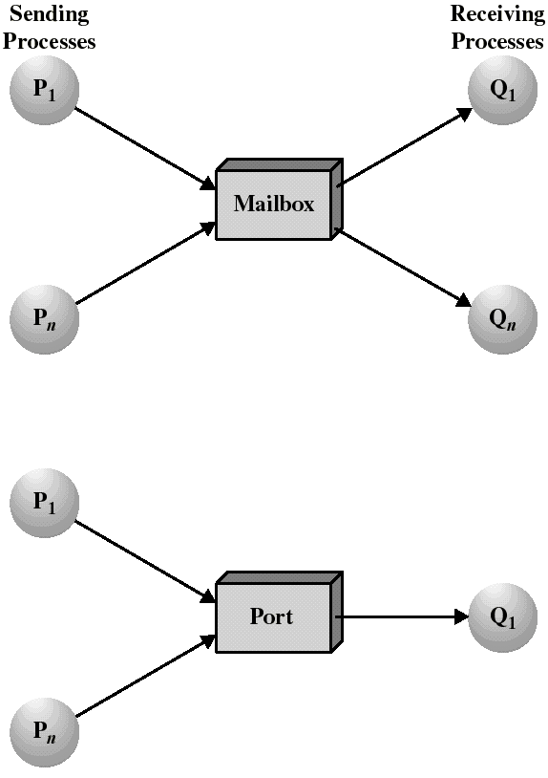
Mailboxes and Ports
A mailbox can be private to one sender/receiver pair.
The same mailbox can be shared among several senders and receivers:
the OS may then allow the use of message types (for selection).
Port: is a mailbox associated with one receiver and multiple senders
used for client/server applications: the receiver is the server.
Notes:
‹#›

Slide 24

Ownership of ports and mailboxes
A port is usually own and created by the receiving process.
The port is destroyed when the receiver terminates.
The OS creates a mailbox on behalf of a process (which becomes the owner).
The mailbox is destroyed at the owner’s request or when the owner terminates.
A. Frank - P. Weisberg
Notes:
‹#›

Slide 25
Mutual Exclusion – Message Passing
create a mailbox mutex shared by n processes.
send() is non-blocking.
receive() blocks when mutex is empty.
Initialization: send(mutex, “go”);
The first Pi who executes receive() will enter CS. Others will be blocked until Pi resends msg.
Process Pi:
var msg: message;
repeat
receive(mutex,msg);
CS
send(mutex,msg);
RS
forever
A. Frank - P. Weisberg
Notes:
‹#›

Slide 26
Bounded-Buffer – Message Passing
The producer place items (inside messages) in the mailbox mayconsume.
mayconsume acts as our buffer: consumer can consume item when at least one message present.
Mailbox mayproduce is filled initially with k null messages (k= buffer size).
The size of mayproduce shrinks with each production and grows with each consumption.
Solution can support multiple producers/consumers.
A. Frank - P. Weisberg
Notes:
‹#›

Slide 27
Bounded-Buffer – Message Passing
Producer:
var pmsg: message;
repeat
receive(mayproduce, pmsg);
pmsg := produce();
send(mayconsume, pmsg);
forever
Consumer:
var cmsg: message;
repeat
receive(mayconsume, cmsg);
consume(cmsg);
send(mayproduce, null);
forever
A. Frank - P. Weisberg
Notes:
‹#›

Slide 28
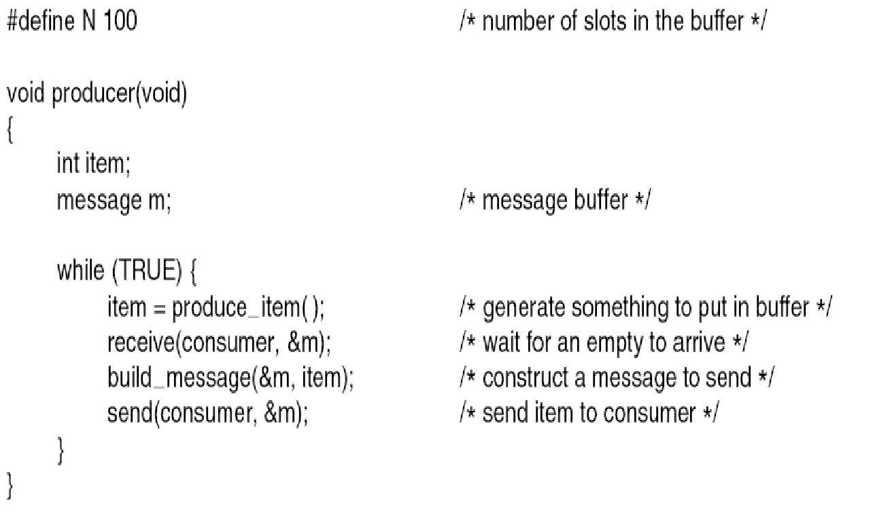
P/C Problem with Message Passing (1)
A. Frank - P. Weisberg
Notes:
‹#›

Slide 29
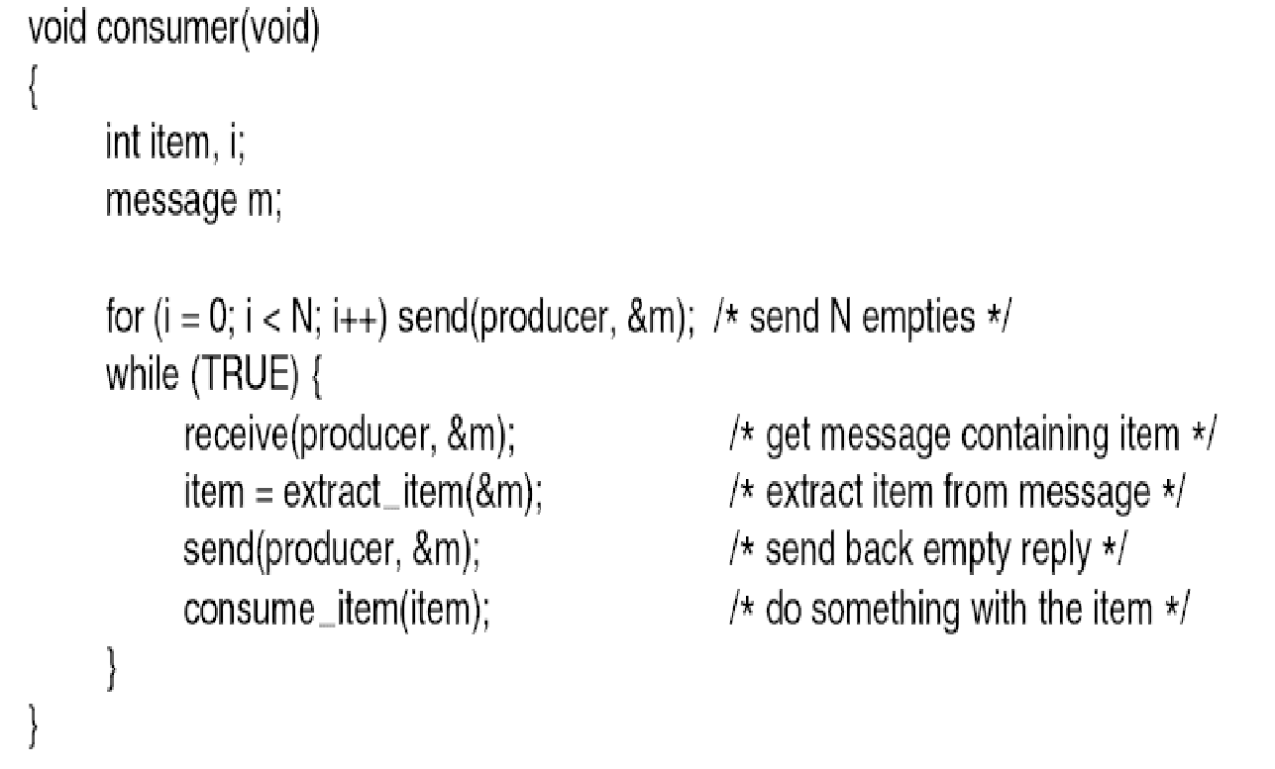
P/C Problem with Message Passing (2)
A. Frank - P. Weisberg
Notes:
‹#›

